Slide 1
Corporate accounting
K. manjula vani

Slide 2
UNIT-1 ACCOUNTING FOR SHARE CAPITAL

Slide 3
MEANING OF COMPANY
Company is a voluntary association of persons formed for the purpose of doing business having a distinct name and limited liability.
It is a juristic person having a separate legal entity distinct from the members who constitute it, capable of rights and duties of its own and endowed with the potential of perpetual succession.
The Companies Act, 1956, states that 'company' includes company formed and registered under the Act or an existing company i.e. a company formed or registered under any of the previous company laws.

Slide 4
FEATURES OF A COMPANY
1. Registration
A company comes into existence only after registration under the Companies Act. But a Statutory Corporation is formed and commence business as notified or stated in the Act and as passed in Legislature. In case of partnership, registration is not compulsory.
2. Voluntary Association
A company is an association of many persons on a voluntary basis. Therefore a company is formed by the choice and consent of the members.
3. Legal Personality
A company is regarded by law as a single person. It has a legal personality. This rule applies even in the case of “One-man Company.”

Slide 5
4. Contractual Capacity
A shareholder of a company, in its individual capacity, cannot bind the company in any way. The shareholder of a company can enter into contract with the company and can be an employee of the company.
5. Management
A company is managed by the Board of Directors, whole time Directors, Managing Directors or Manager. These persons are selected in the manner provided by the Act and the Articles of Association of the company. A shareholder, as such, cannot participate in the management.
6. Permanent Existence
The company has perpetual succession. The death or insolvency of a shareholder does not affect its existence. A company comes into end only when it is liquidated according to provision of the Companies Act.

Slide 6
KINDS OF COMPANIES
Form the point of view of liability there are three kinds of Companies
(1) Limited Companies
In case of such companies, the liability of each member is limited to the extent of a face value of shares held by him. Suppose A takes a share of Rs 10., he remains liable to the extent of that amount. As soon as that amount in paid, he is no more liable.
(2) Guarantee Companies
The liability of the member of such companies is limited to the amount he has undertaken to contribute to the assets of the company in the event of its wound up. This guaranteed amount is limited to fixed sum which is specified in the memorandum.
(3) Unlimited Companies
They are nothing but large partnership registered under the Companies Act and the members just like partners have unlimited liability and both share contribution as well as their property are at stake when the company is to be wound up. Such companies are rare these days.

Slide 7
From the point of view of Public investment companies may be of two kinds:
(1) Private Companies :
A private company means a company which by its articles (a) restricts the right to transfer its shares, if any (b) limits the number of its members to fifty excluding past or present employees of the company who are also members of the company. (c) Prohibits any invitation to the public to subscribe for any shares in our debentures of the company.
(2) Public Companies :
Public companies are those companies which are not private companies. All the three ABOVE restrictions are not imposed on such companies.

Slide 8
SHARE CAPITAL ISSUE AND FORFEITURE OF SHARES
1. AUTHORISED CAPITAL is also referred to, at times, as registered capital. This is the total of the share capital which a limited company is allowed (authorized) to issue to its shareholders. It presents the upper boundary for the actually issued share capital (hence also 'nominal capital').
2. Issued Share Capital is the total of the share capital issued to shareholders. This may be less than the authorized capital.
3. Subscribed Capital is the portion of the issued capital, which has been subscribed by all the investors including the public. This may be less than the issued share capital as there may be capital for which no applications have been received yet ('unsubscribed capital').
4. Called up Share Capital is the total amount of issued capital for which the shareholders are required to pay. This may be less than the subscribed capital as the company may ask shareholders to pay by installments.
5. Paid up Share Capital is the amount of share capital paid by the shareholders. This may be less than the called up capital .

Slide 9
JOURNAL ENTRIES FOR ISSUE OF SHARES
(1) On receipt of application money
Bank Account Dr
To Share Application A/c
(Being the application money on....shares..@ Rs.per share)
(2) On allotment of shares
First of all application money on allotted shares is transferred to shares
capital account
Share Application Account Dr
To Share Capital A/C
(Being the application money transferred to Share Capital Account)
(b) Those applicants who could not be allotted any share, their application money
will be returned.
Share Application Account Dr
To Bank Account
(Being the application money of shares returned)

Slide 10
Issue of shares at premium
If a company issues its shares at a price more than its face value, the shares
are said to have been issued at Premium. The difference between the issue
price and face value or nominal value is called ‘Premium’. If a share of
Rs 10 is issued at Rs 12, it is said to have been issued at a premium of
Rs 2 per share. The money received as premium is transferred to Securities
Premium A/c. The Companies Act has laid down certain restrictions on the utilization of the amount of premium.
According to Section 78 of this Act, the amount of premium can be
utilized for :
(i) Issuing fully-paid bonus shares;
(ii) Writing off preliminary expenses, discount on issue of shares,
underwriting commission or expenses on issue;
(iii) Paying premium on redemption of Preference shares or Debentures.
(iv) For purchase of its own shares.

Slide 11
Accounting Treatment of premium on Issue of Shares
Following is the accounting treatment of Premium on issue of shares :
(a) Securities premium collected with share Application money :
If the Securities premium is collected on application and the company has taken decision about the allotment of shares, the following journal entry is made :
Share Application A/c. Dr
To Securities Premium A/c
(The amount of Securities premium received on application of the allotted shares is transferred to Securities Premium A/c)
(b) Premium collected with Allotment money or Calls.
If the company decides to demand the premium with share Allotment or and share call money, the journal entry made is:
Share Allotment A/c Dr
Or/and
Share Call A/c Dr
To Securities Premium A/c
(Adjustment of share premium due on……shares @Rs…….per share.)

Slide 12
ISSUE OF SHARES AT DISCOUNT
When the issue price of share is less than the face value, shares are said
to have been issued at discount. For example if a company issues its shares
of Rs 100 each at Rs. 90 each, the shares are said to be issued at discount.
The amount of discount is Rs 10 per share (i.e. Rs 100 – Rs 90). Discount
on shares is a loss to the company.
Section 79 of Companies Act 1956 has laid down certain conditions subject
to which a company can issue its shares at a discount. These conditions are
as follows :
(i) At least one year must have elapsed from the date of commencement
of business;
(ii) Such shares are of the same class as had already been issued;
(iii) The company has sanctioned such issue by passing a resolution in
its General meeting and the approval of the court is obtained.
(iv) Discount should not be more than 10% of the face value of the
share and if the company wants to give discount more than 10%,
it will have to obtain the sanction of the Central Government.

Slide 13
FULL, UNDER AND OVER SUBSCRIPTION
A company decides to issue number of shares to raise capital. It invites public to buy these shares. Now there may be three situations :
1.Full Subscription
Company may receive applications equal to the number of shares company has offered to people. It is called full subscription. In case of full subscription the journal entries will be made as follows :
(a) On receipt of application money
Bank A/c Dr
To Share Application A/c
(Application money received for ......... shares)
(b) On allotment of shares
Share Application A/c Dr
To Share Capital A/c
(Application money of shares transferred to capital A/c on their allotment)

Slide 14
II. The company does not receive application equal to the number of shares
offered for subscription, there may be two situations :
(i) under subscription
(ii) over subscription
(i) Under subscription
The issue is said to have been under subscribed when the company receives
applications for less number of shares than offered to the public for
subscription. In this case company is not to face any problem regarding
allotment since every applicant will be allotted all the shares applied for.
But the company can proceed with allotment provided the subscription for
shares is at least equal to the minimum required number of shares termed
as minimum subscription.
(ii) Over Subscription
When company receives applications for more number of shares than the
number of shares offered to the public for subscription it is a case of over
subscription. A company cannot allot more shares than what it has offered.
In case of over subscription, company has the following options

Slide 15
If the application money received on partially accepted applications is more
than the amount required for adjustment towards allotment money, the
excess money is refunded. However, if the Articles of the company so
authorize, the directors may retain the excess money as calls in advance to
be adjusted against the call/calls falling due later on.
the entry is made :
Share Application A/c Dr
To Call-in-advance A/c
(The adjustment of excess share application money retained as call-in advance in respect of ... shares).

Slide 16
Option I
1.Rejection of Excess Applications and Money Returned
The company may reject the applications for shares in excess of the shares
offered for issue and a letter of rejection is sent to such applicants. In this
case the application money received from these applicants is refunded to
them in full.
The journal entry made is as follows:
Share Application A/c Dr
To Bank A/c
(Application money on … shares refunded to the applicants)
(ii) Excess application money adjusted towards sums due on allotment.
Journal entry made is :
Shares Application A/c Dr
To Share Allotment A/c
(Excess application money adjusted towards sums due on allotment)

Slide 17
If the application money received on partially accepted applications is more
than the amount required for adjustment towards allotment money, the
excess money is refunded. However, if the Articles of the company so
authorize, the directors may retain the excess money as calls in advance to
be adjusted against the call/calls falling due later on.
the entry is made :
Share Application A/c Dr
To Call-in-advance A/c
(The adjustment of excess share application money retained as call-in advance in respect of ... shares).

Slide 18
Option II
Partial acceptance of Applications.
In some cases the company accepts the applications for subscription
partially. It means that the company does not allot the full number of shares
applied for. For example if an applicant has applied for 5000 shares and
is allotted only 2000 shares, then the applications is said to have been
partially accepted. The company may evolve some formula of accepting
applications partially or making proportionate allotment/ the Pro rata allotment which means that the applicants are allotted shares proportionately. In such a case the company adjusts the excess share money received on application towards share allotment money due on partially accepted applications.
The journal entry recording the adjustment of application money towards share allotment money, is as under :
Share Application A/c Dr
To Share Allotment A/c
(Share application money transferred to Share Allotment Account in respect of ... shares)

Slide 19
CALLS IN ADVANCE AND CALLS IN ARREARS
If a shareholder pays any amount to company before it is demanded, it is
called Call-in-Advance. This amount is put in a separate account known
as Calls-in-Advance A/c. This amount is not shown as capital of the
company, till such time the company makes a demand from all the
shareholders.
Call-in-Advance A/c is shown on the liabilities side of the Balance Sheet.
For example if a company issued shares of Rs 10 on which
it has already called Rs 5. Against the uncalled portion of Rs 5 per share
the company makes a call Rs 3 per share, the entry for call money due will
be made only for Rs 3 per share. Now suppose a shareholder pays Rs 5 per share including the uncalled amount of Rs 2 per share along with the
call money, it means he has paid Rs 2 per share in advance, which will be
credited to calls in Advance A/c.
The company is required to pay interest on this amount @ 6% till the date of its appropriation.

Slide 20
Accounting treatment
Following journal entry is made for calls-in-advance.
Bank A/c Dr
To Calls-in-Advance A/c
(Calls in advance received on…….shares @ Rs …….per share)
Appropriation of calls-in-Advance A/c say in the final call
Journal entry will be :
Calls-in-Advance A/c Dr
To Share Final call A/c
(Calls in advance amount adjusted)
For interest given on Calls-in-Advance
Journal entry will be
Interest on calls-in-Advance A/c Dr
To Bank A/c
(Interest paid on the amount of Call-in-Advance)

Slide 21
Calls in arrears
When the company sends notice to the shareholders to pay allotment and
call money, it has to be paid by them within the specified time period.
If it is not paid by any one or more of the shareholders, the unpaid amount
becomes arrears due from them. Such arrears are transferred to an account
termed as Calls-in-Arrears A/c. The company is authorized to charge interest
on calls-in-Arrears @ 5% p.a. for the intervening period
Accounting Treatment
The following journal entry is made to record Calls-in-Arrears:
Calls-in-Arrears A/c Dr
To Share Allotment/Call A/c
(Share allotment/ Call money not received on …. shares)
When the unpaid balance is received later on the following journal entry
is made:
Bank A/c Dr
To Calls in Arrears A/c
(Amount due on allotment/ call remaining unpaid now received on……
shares.)

Slide 22
FORFEITURE OF SHARES
If a shareholder fails to pay the due amount of allotment or any call on shares
issued by the company, the Board of directors may decide to cancel his/her membership of the company. With the cancellation, the defaulting shareholder also loses the amount paid by him/her on such shares. Thus, when a shareholder is deprived of his/her membership due to non payment
of calls, it is known as forfeiture of shares.
1. Forfeiture of shares issued at Par
When shares issued at par are forfeited the accounting treatment will be
as follows:
(i) Debit Share Capital Account with amount called up (whether received
or not) per share up to the time of forfeiture.
(ii) Credit Share Forfeited A/c. with the amount received up to the time
of forfeiture.
(iii) Credit ‘Unpaid Calls A/c’ with the amount due on forfeited shares. The

Slide 23
FORFEITURE OF SHARES ISSUED AT PREMIUM AND AT
DISCOUNT
In case shares are issued at premium and thereafter forfeited there can be
two situations :
Premium on shares has been received prior to the forfeiture.
Amount of premium on shares has not been received and it still stands
credited to the Securities Premium A/c.
1. Premium money has been received prior to the forfeiture
If the amount of premium on shares forfeited has been received by the
company prior to the forfeiture, securities Premium A/c will not affected. In this case the journal entry of forfeiture of shares will be similar to the entry made as if the shares had been issued at par.
The journal entry will be :
Share Capital A/c …Dr
To Share forfeited A/c
To Unpaid Calls A/c./Calls in arrears A/c
(forfeiture of share issued at premium)

Slide 24
2. Premium on shares has not been received and stands credited to Securities Premium A/c as due but not paid.
When a share is forfeited on which the amount of premium has been made
due but has not been received, either wholly or partially, the Securities
Premium A/c will be cancelled. At the time of making due, Securities
Premium A/c will be credited.
The journal entry will be as follows:
Share Capital A/c Dr
Securities Premium A/c Dr
To Share Forfeited A/c
To Unpaid call A/c.
(Forfeiture of shares originally issued at premium due to non payment of
dues).

Slide 25
Forfeiture of shares issued at discount
Discount on issue of shares is a loss to the company. When shares issued
at a discount are forfeited for non payment of dues, the discount allowed
on such shares is written back. At the time of issue of shares, Discount
on issue of Shares A/c is debited and when forfeited, this account is credited
to cancel the discount allowed on such shares.
In this case the following journal entry is made :
Share Capital A/c Dr.
To Share Forfeited A/c
To Discount on Issue of Shares A/c
To Unpaid call A/c
(Forfeiture of shares originally issued at discount for non payment of dues).

Slide 26
REISSUE OF FORFEITED SHARES
Forfeited shares may be reissued by the company directors for any amount bit if such shares are issued at a discount then the amount of discount should not exceed the actual amount received on forfeited shares plus original discount on reissued shares, if any.
The following journal entry will be passed :
Bank a/c Dr. ( amount received)
Discount on issue of shares a/c Dr.(with original rate of discount if issued at dis)
Share forfeited a/c(loss on issue)
To share capital a/c( with face value of shares )
To securities premium a/c(if shares are reissued at premium)
After the reissue if there is no balance in shares forfeited account then there will be no capital profit. But where there is profit on the reissue of forfeited shares , such a profit is treated as a capital profit and balance or amount relating to shares reissued will be transferred to capital reserve by following entry ;
Share Forfeited a/c
To capital reserve a/c

Slide 27
UNIT-II: issue and redemption of debentures

Slide 28
Definition of debenture
It includes debenture stock , bonds , and any other securities of a company whether constituting a charge on the assets of a company or not
Features of Debentures
It is a document which acknowledges the debt of company
It carries interest at fixed rate
A debenture is secured by charge on the assets of company
They do not enjoy the voting rights

Slide 29
Nature of debenture
It is a part of borrowed funds
They are the creditors of the company
Debenture holders gets interest even if there are losses
They are redeemed on due date
Debenture holders don’t enjoy voting rights
They can be converted into equity shares
There are no legal restrictions on purchase of its own debentures

Slide 30
Types of debentures
Simple or unsecured debentures-
These are those debentures which have no security
Secured debentures-
These are those debentures which are secured against the particular assets of the company
Redeemable debenture-
These are those debentures that will be repaid by the company at the end of specified period during the existence of company
Irredeemable debenture-
They are not to be repaid during the lifetime of company
Convertible debenture-
Debentures which gets converted into equity shares Non convertible debenture- they cannot get converted into equity shares
Registered debentures-
These are those dentures in which detail of debenture holders are registered in the register of company
Bearer debentures-
These are those debentures which can be transferred by way of delivery and company does not keep any record of the debenture holder

Slide 31
Redemption of Debenture
Discharge of liability on account of debentures earlier issued by the company is called as redemption of debenture
Methods of Redemption of debentures
Redemption out of Profits
Redemption out of capital
Redemption by conversion
Redemption of debentures by purchasing own debentures in the open market

Slide 32
Sources of redemption of debenture
Redemption out of fresh capital
Redemption by conversion
Redemption out of sale proceed
Redemption out of Existing Capital
Redemption out of profits

Slide 33
Unit-III: Valuation of Goodwill

Slide 34
Meaning of Goodwill
It is a good name or reputation earned by a firm.
It is an intangible asset.
It is the value of business over and above the value of its assets.
It is the difference between the purchase price and the value of net assets.
It has a positive impact on the future turnover and profits of the business.

Slide 35
Factors Affecting Valuation of Goodwill
1. Good Public Relation
2. Regular Customers
3. Quality Product in Reasonable Price
4. Management Skills
5. Location of Business
6. Good Relation with Suppliers
7. Employees

Slide 36
Methods of Valuation of Goodwill
1. Simple Average Profit Method
2. Super Profit Method
3. Weighted Average Method
4. Capitalization Method
  a. Capitalization of Average Profit Method
  b. Capitalization of Super Profit Method

Slide 37
1. Simple Average Profit Method
Goodwill = Average Profit * Number of year of purchase
Average Profit = Total Profit / Number of Years
Number of years of purchase means the number of year for which the firms is likely to earn the same amount of profit.
Things to consider before calculating the average profits :-
1. Any abnormal profit should be deducted from the net profits of that year.
2. Any abnormal loss should be added back to the net profits of that year.
3. Non-operating incomes e.g. income from investments should be deducted from the net profits of that year.

Slide 38
2. Super Profits Method
Goodwill is calculated on the basis of Super Profit i.e. the excess of actual profits over the average profits.
Formula:-
Goodwill = Super Profit * No. of years purchase
Super Profit = Average Profits - Normal Profits
Normal Profits = Capital Employed * Normal Rate of Return / 100

Slide 39
3. Weighted Average Profit method
This method is the modified version of the simple average profit method. In this method, each year’s adjusted profits are multiplied with the respective number of weights in order to calculate the total product. The total of products is then divided by the total of weights to calculate the weighted average profits. Thereafter, the weighted average profits are multiplied by the number of years of purchase.
Formula :
Weighted Average Profits = Total Products o Profits / Total of Weights
Goodwill = Weighted Average Profits * No. of years of purchase

Slide 40
4. Capitalization of Profit Method
Capitalization of Average Profit Method
= Average Profit / NRR * 100
b. Capitalization of Super Profit Method
= Super Profit / NRR * 100

Slide 41
UNIT – IV:Valuation of shares

Slide 42
Valuation of shares
Need for valuation:
1. At the time of amalgamation.
2. When loan is granted on the security of shares.
3. When preference shares or debentures are converted into equity shares.
4. When equity shareholders are to be compensated on acquisition of their shares by the govt. under a scheme of nationalisation.

Slide 43
Factors affecting valuation of shares
Nature of the business
Demand and supply for shares
Govt. policy
Past performance of the company
Growth prospectus of the company
The management of the company
The economic climate
Accumulated reserves
Prospects of bonus or rights issue
Dividend declared etc.

Slide 44
Methods for valuation
Net assets basis (or intrinsic value) method
Yield basis method
Dual (or fair value) method

Slide 45
Net assets basis method
Net tangible assets basis (excluding goodwill)
Under this method, net tangible assets are estimated in order to value the shares.
Net tangible assets = Assets – Liabilities
Assets are taken at their actual values (market values) and not at book values. Fictitious assets like preliminary expenses are excluded. All the liabilities (whether in books or not) are deducted. Non trading assets are also included in the assets. Amount payable to preference shareholders is also deducted.
value of share = net tangible assets/no. of equity shares

Slide 46
2. Net assets (including goodwill)
In this method, goodwill is included with other tangible assets for the valuation of shares. Goodwill is taken at its actual value which maybe equal to, more than or less than the book value. There maybe some value of goodwill even if it is not shown in the books.

Slide 47
Yield method
Following steps are taken for calculating the value of shares under this method:
1. Calculation of average expected future profits (profit available for equity shareholders).
2. Calculation of expected return.
Expected return= expected profits/equity share capital *100
3. Value of share= Expected rate/normal rate *paid up value of one share

Slide 48
Dual or fair value method
It is simply a combination of the previous two methods. According to this method,
Value of share= net asset method value + yield method value/2
For eg:
Net asset method value: Rs. 10
Yield method value: Rs. 12
Fair value: Rs.10+Rs. 12/2 =Rs. 11

Slide 49
UNIT-V: COMPANY FINAL ACCOUNTS

Slide 50
COMPANIES ACT 2013
1 Schedule III
Format of balance sheet.
Format of profit and loss Account.

Slide 51
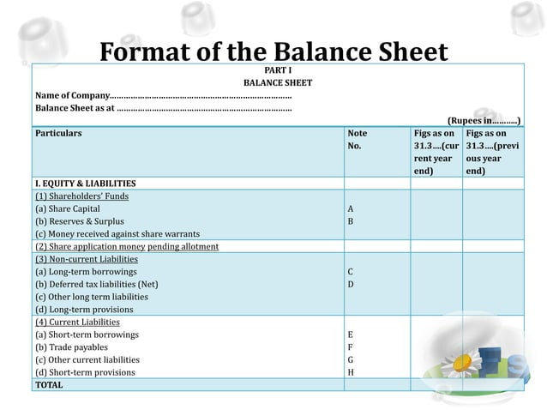

Slide 52
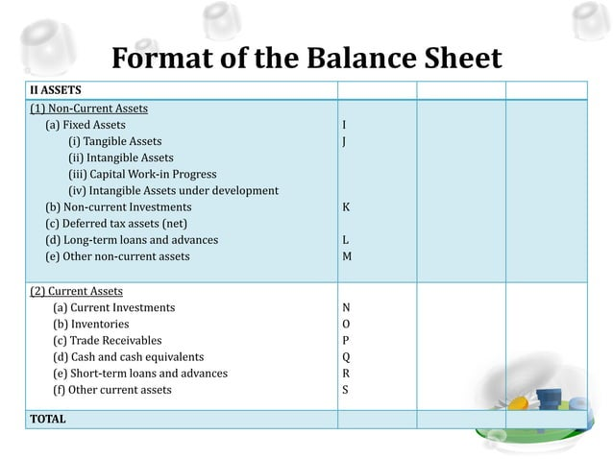

Slide 53
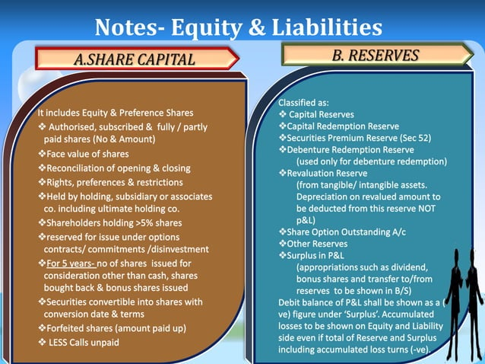

Slide 54
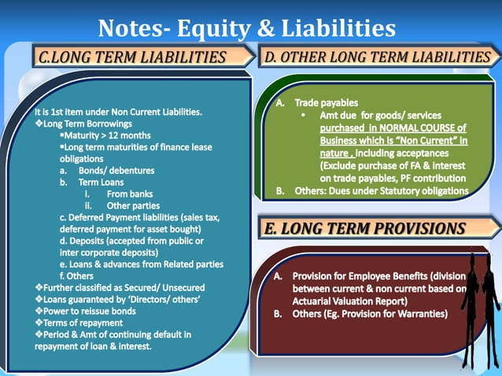

Slide 55
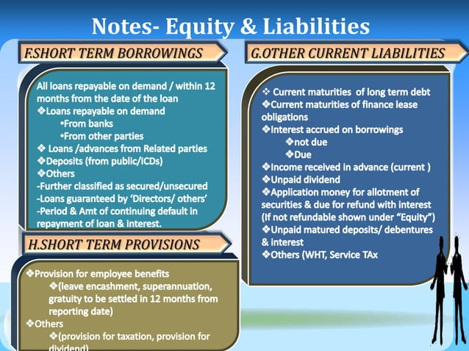

Slide 56
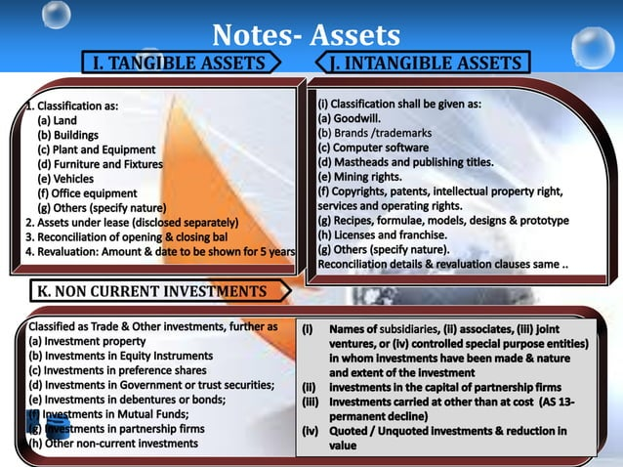

Slide 57
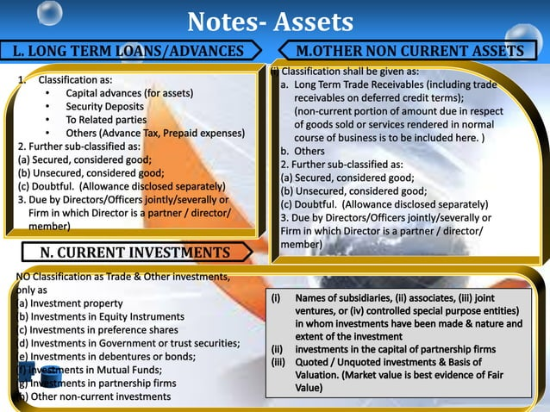

Slide 58
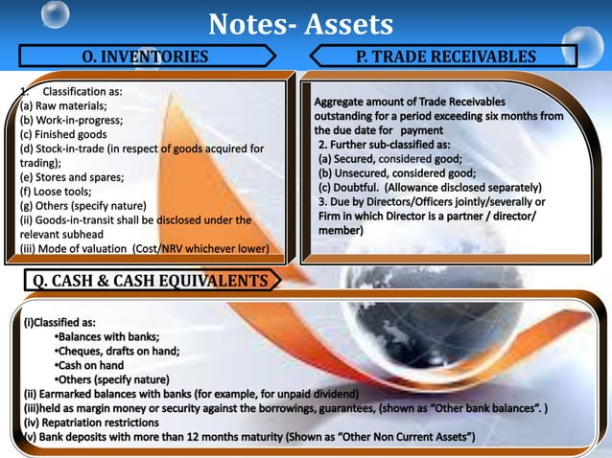

Slide 59
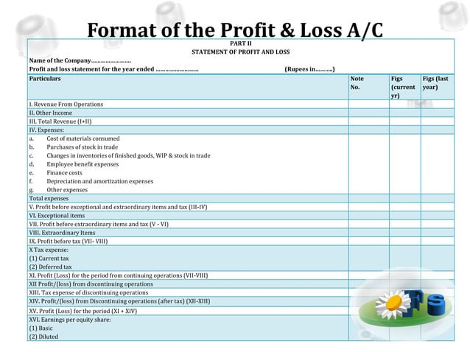

Slide 60
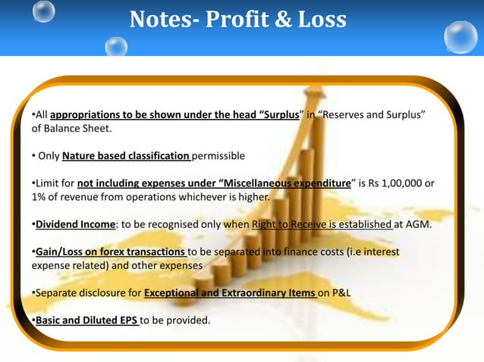

Slide 61
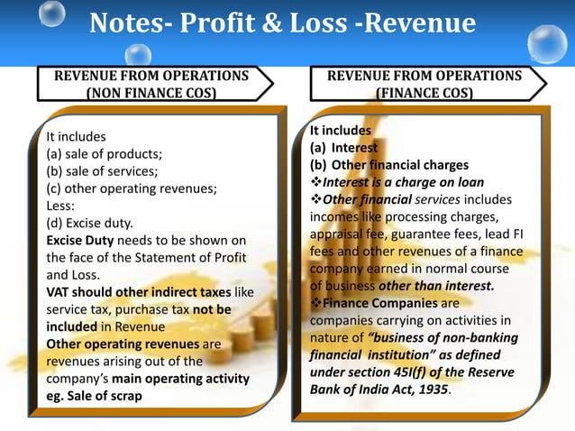

Slide 62
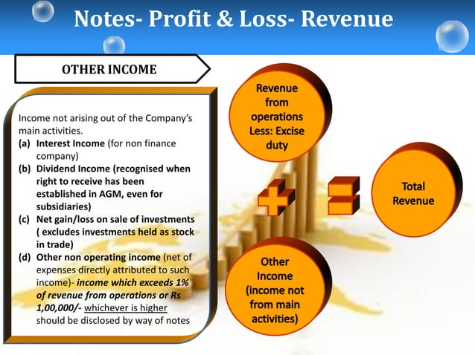

Slide 63
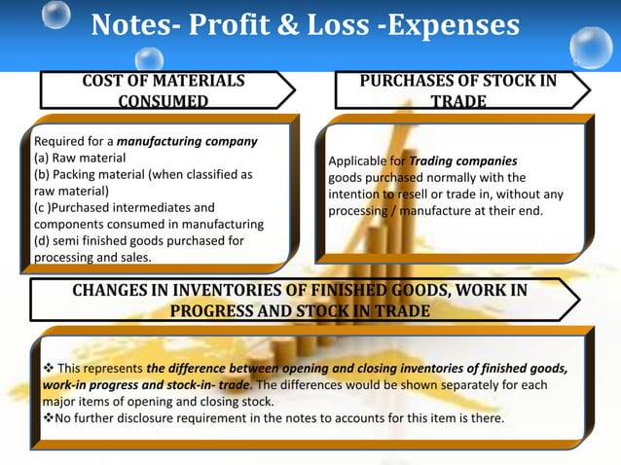

Slide 64
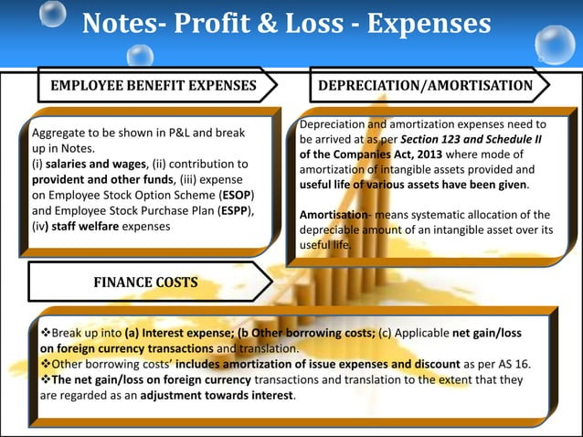

Slide 65
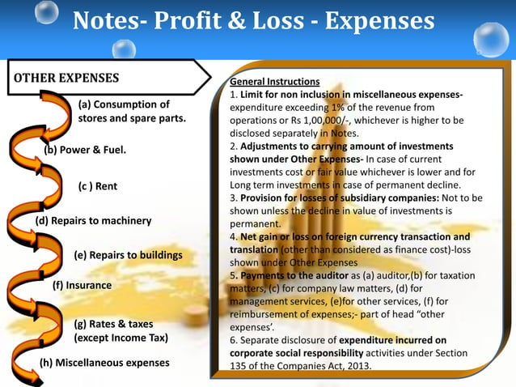

Slide 66
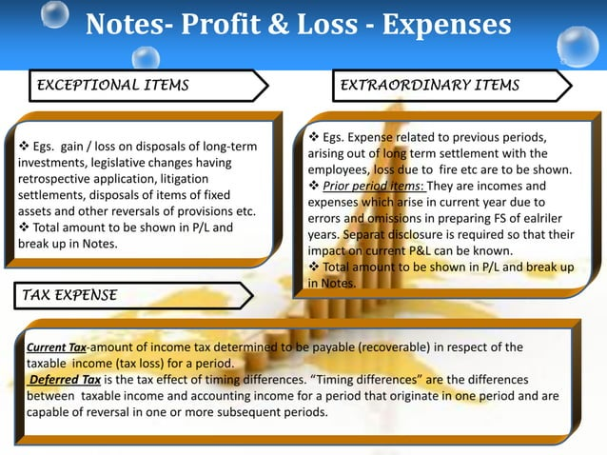

Slide 67
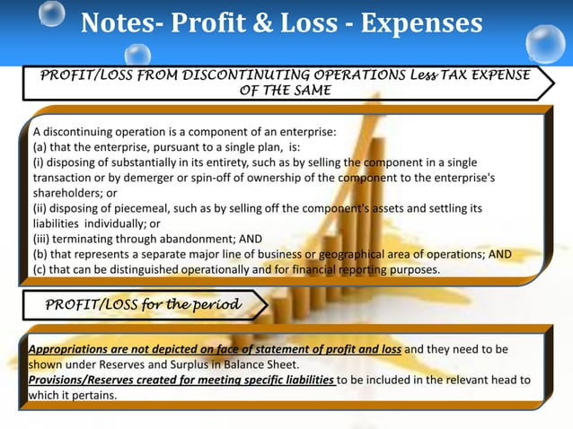

Slide 68
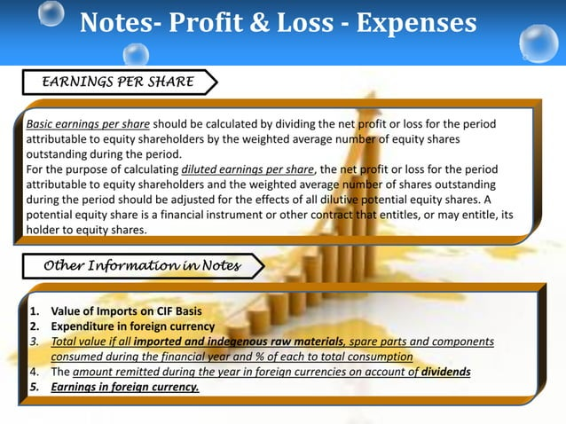

Slide 69
THANK YOU

